Slide 1
Employee Data Analysis using Excel
STUDENT NAME: MONISREE G
REGISTER NO: 422200888
DEPARTMENT: BCOM[INFORMATION SYSTEMS MANAGEMENT
COLLEGE SHRI KRISHNASWAMY COLLEGE FOR WOMEN

Slide 2
PROJECT TITLE
Employee Performance Analysis using Excel

Slide 3


AGENDA
Problem Statement
Project Overview
End Users
Our Solution and Proposition
Dataset Description
Modelling Approach
Results and Discussion
Conclusion
3/21/2024 Annual Review

Slide 4

PROBLEM STATEMENT
Inconsistent Performance Evaluation: Current performance evaluations are not standardized, leading to inconsistent and subjective assessments.Lack of Insight into Employee Contributions: Difficulty in correlating individual contributions with overall business performance, affecting compensation and recognition.Unclear Training Impact: Uncertainty about the effectiveness of training programs on employee performance and career progression.Absenteeism Impact: Inadequate understanding of how attendance patterns impact team productivity and individual performance.Performance Trends and Patterns: Absence of a systematic approach to identify performance trends and patterns across departments and positions.

Slide 5

PROJECT OVERVIEW
Standardize Performance Metrics: Establish a consistent set of performance metrics across the organization to enable objective evaluations.Identify Performance Trends: Analyze employee data to identify trends, patterns, and correlations between various performance indicators.Enhance Decision-Making: Provide actionable insights to improve decisions related to promotions, compensation, training, and resource allocation.Optimize Training Programs: Assess the impact of training on employee performance to refine and enhance training initiatives.Address Attendance Issues: Understand the effects of absenteeism on productivity and performance, and develop strategies to manage it effectively

Slide 6

WHO ARE THE END USERS?
The end users of employee data analysis span across various departments and roles within an organization, each utilizing the insights for different purposes. By effectively analyzing and interpreting employee performance data, these stakeholders can make more informed decisions, improve management practices, and contribute to overall organizational success

Slide 7

OUR SOLUTION AND ITS VALUE PROPOSITION
Our solution provides a robust and integrated employee data analysis system designed to enhance performance management, optimize talent development, and drive strategic decision-making within organizations. This system consolidates and analyzes employee data from various sources, offering actionable insights through advanced analytics and intuitive reporting tools.

Slide 8
Dataset Description
The employee data analysis dataset contains comprehensive information on various aspects of employee performance, behavior, and contributions within the organization. This dataset is designed to support in-depth analysis and reporting on employee performance, productivity, and development needs.

Slide 9

THE "WOW" IN OUR SOLUTION
The WOW (World of Wonders) Solution in employee data analysis goes beyond basic data collection and reporting to deliver an exceptional and transformative experience. It integrates advanced analytics, innovative technology, and user-centric design to provide deep insights, actionable recommendations, and a competitive edge in talent management. Here's how the WOW Solution stands out:
3/21/2024 Annual Review
9

Slide 10
MODELLING
Employee data analysis modeling involves creating and using various models to analyze employee performance, behavior, and other relevant metrics to derive insights and make informed decisions. The goal is to transform raw employee data into actionable information that can drive HR strategies, improve performance, and optimize workforce management. Here’s a structured approach to employee data analysis modeling:
10

Slide 11
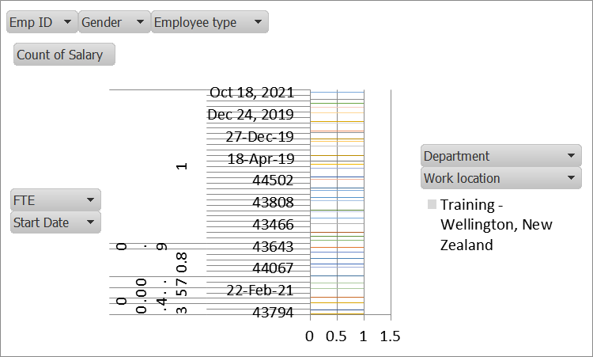
RESULTS
11

Slide 12
conclusion
Employee data analysis is a powerful tool that transforms raw data into actionable insights, enabling organizations to make informed decisions and optimize their workforce management practices. Through the systematic collection, processing, and analysis of various employee metrics, organizations can achieve several key benefits and outcomes:

